Slide 1
Basic Power Query
Prepared By: Lougine De Mesa
Notes:
1

Slide 2
TABLE OF CONTENTS
Duration: 40 – 60mins
01
04
07
What is Power Query?
Power Query Editor
Demo / Q&A
02
05
Combining Data and Transformation
08
Sources
Assessment
03
06
Navigation
Errors and Troubleshooting

Slide 3
What is Power Query?
“Power Query is a tool in Excel that helps you connect to, combine, and clean data easily— without needing to manually adjust your data every time.”
Highlight use cases:
Cleaning messy data
Importing data from various sources
Merging multiple tables
Automating repetitive data prep tasks

Slide 4
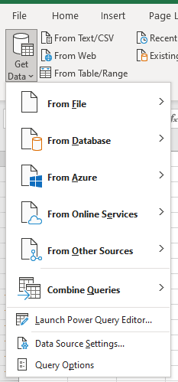
Sources - Power Query can connect to a wide variety of data sources to extract and transform data. The source of a Power Query refers to the origin from which the data is retrieved.
Common sources for Power Query:
Files:
Excel Workbooks, Text/CSV files, XML files, JSON files, PDF files, SharePoint folders, and various other file types.
Databases:
SQL Server databases, Access databases, Oracle databases, MySQL databases, PostgreSQL databases, IBM Db2 databases, and many other relational and non-relational databases.
Online Services:
SharePoint Online lists, OData feeds, Azure services (like Azure SQL Database, Azure Data Lake Storage), Dynamics 365, Salesforce, and other cloud-based platforms.
Other Sources:
Blank queries (where data is manually entered or generated using M language), web pages (by extracting data from HTML tables), and existing tables or ranges within the current Excel workbook or Power BI data model.

Slide 5
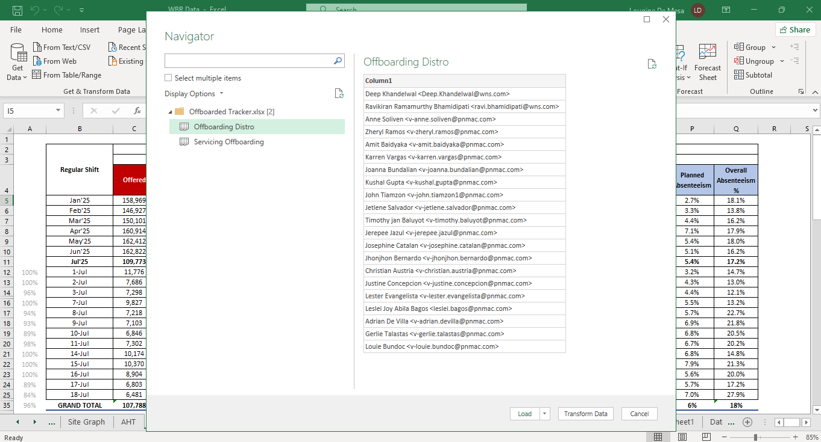
Navigator window - is an interface that appears when connecting to certain data sources. It facilitates the selection and preview of data objects available within the chosen source.
Load:
Selecting this button directly loads the chosen data into your destination without opening the Power Query Editor. This option is suitable when the data is already in the desired format and requires no further cleaning or manipulation.
Transform Data:
Clicking this button opens the Power Query Editor, a dedicated environment where you can apply a wide range of transformations to your data before loading it.

Slide 6
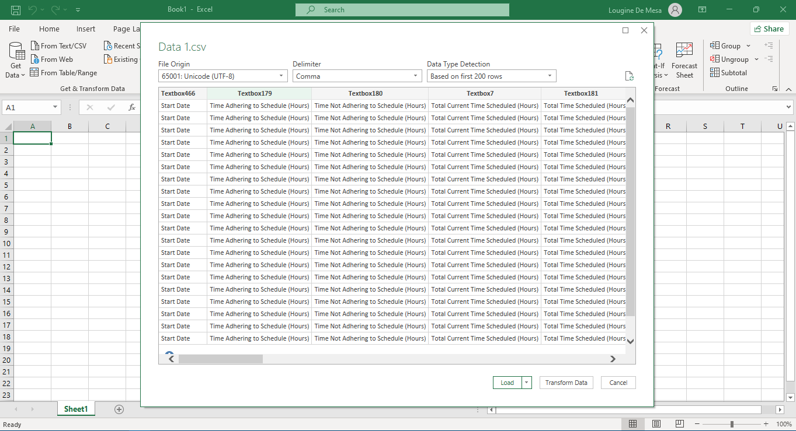
Data Preview - the ability to view and interact with data before it's fully loaded into a worksheet or data model.

Slide 7
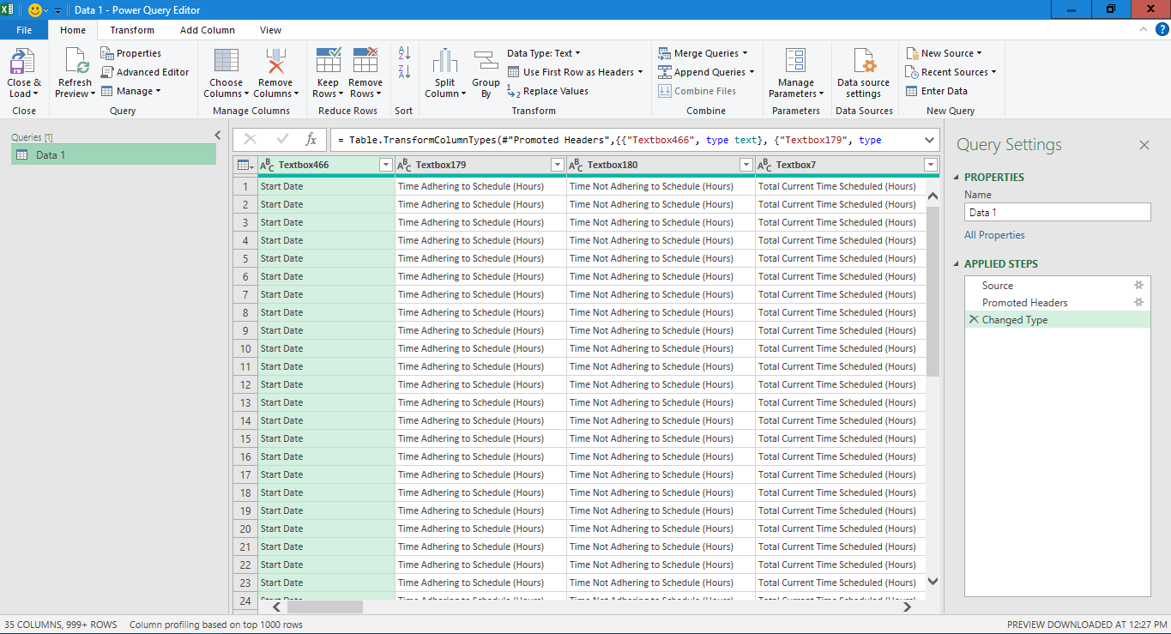
Power Query Editor
Ribbon
Applied Step
Data Preview
Queries pane

Slide 8
Basic Navigation and Interface
This is where all the transformation happens— it records your steps and lets you undo, edit, and automate them. Key sections:
Top: Ribbon - it usually refers to a section or a tab within the ribbon interface of a software application that specifically contains tools for data or object manipulation.
Left: Queries pane - a user interface that lists all available queries, tables, parameters, and custom functions.
Center: Data preview - a feature that allows you to inspect a sample of your data, often at different stages of processing or transformation, to ensure its quality and accuracy before committing to a full data pipeline or process.
Right: Applied Steps - a list of all the transformations applied to your data.

Slide 9
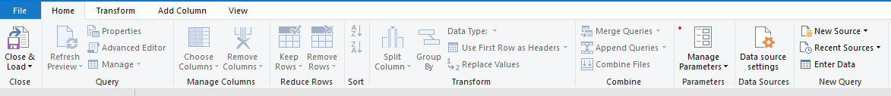
Combining Data
Merging Queries
Appending Queries
Combine Files
Group By

Slide 10
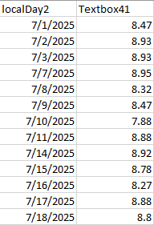
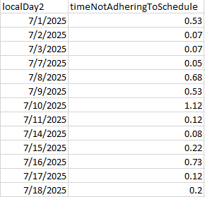
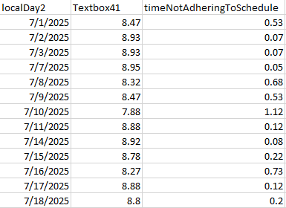
Merging Queries - Merging queries combines two tables based on matching values in one or more common columns, similar to a database join or a VLOOKUP.

Slide 11
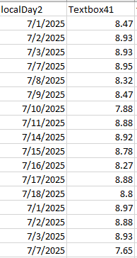
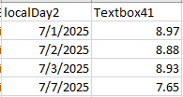
Appending Queries - Appending queries combines rows from multiple tables into a single table. This is useful when you have tables with the same structure but different data (e.g., monthly sales reports).

Slide 12
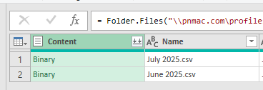
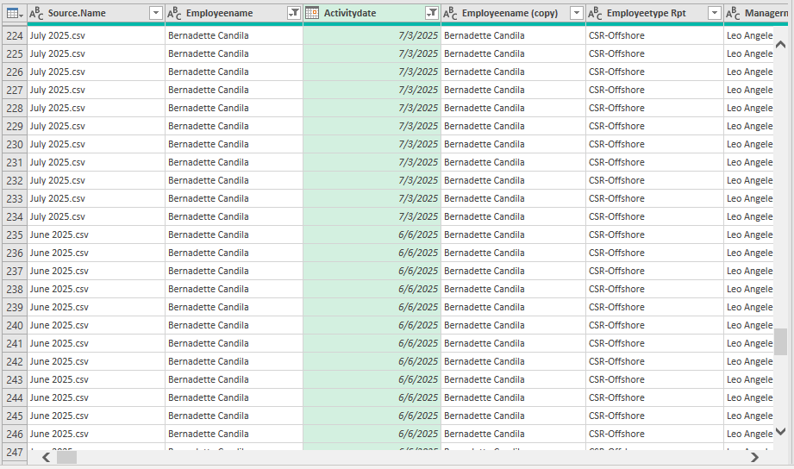
Combine Files - Used to merge data from multiple files into a single table. Select Get Data > From File > From Folder. >Transform Data.

Slide 13
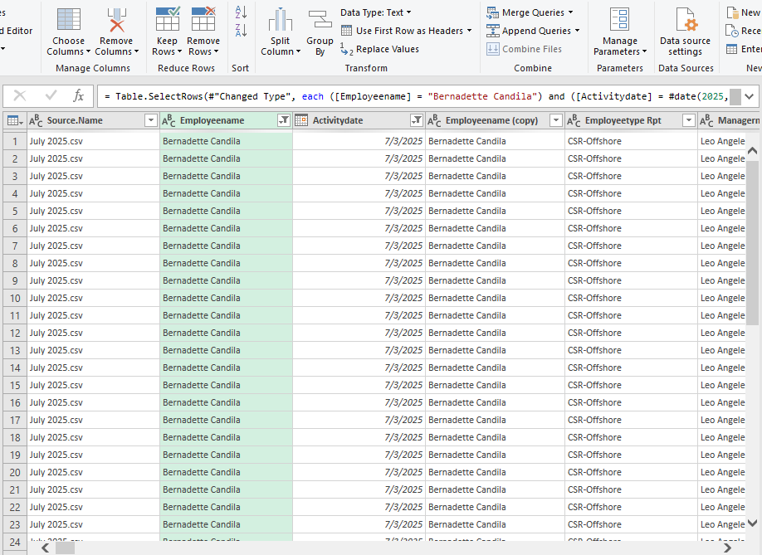
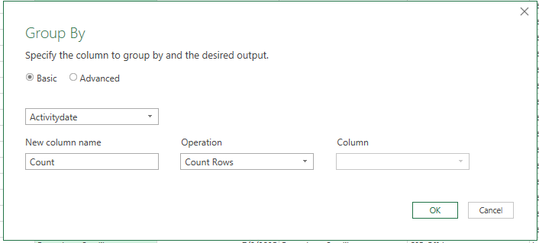

Group By - While not directly combining tables, "Group By" allows for summarizing and aggregating data within a single table, which can be a form of data combination and transformation.

Slide 14
Basic Transformations
Remove columns
Rename headers
Remove duplicates
Fill down
Split columns (by delimiter or number of characters)
Change data types
Replace values
Filter rows (e.g., remove nulls)
Sort

Slide 15
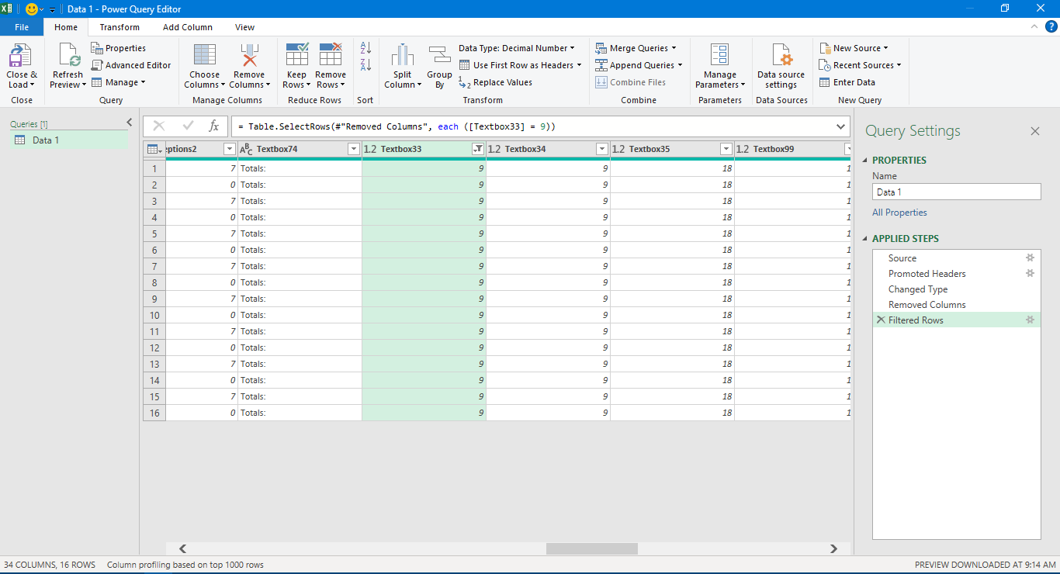
How to Undo?
In Power Query, there is no traditional "undo" button like in other applications (e.g., Ctrl+Z). Instead, to undo a step, you directly manage the "Applied Steps" pane.
To undo a single step:
Navigate to the "Applied Steps" pane in the Power Query Editor.
Locate the specific step you wish to undo.
Hover over the step, and an "X" (red cross mark) icon will appear next to it.
Click the "X" icon to delete that step. The data will revert to its state before that step was applied.

Slide 16


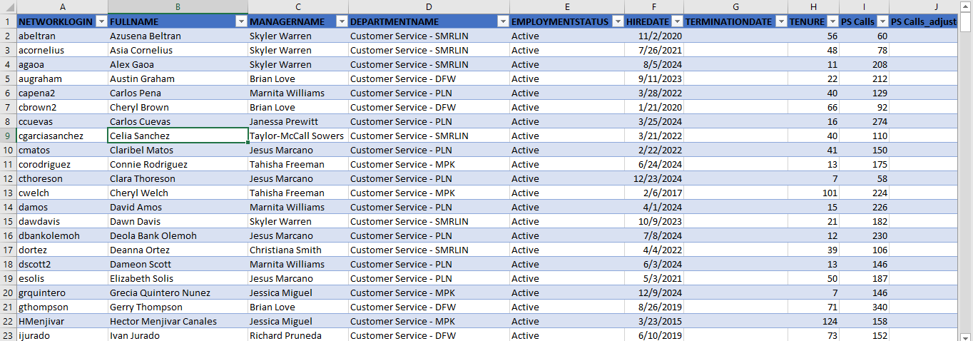
Refresh Preview - button updates the data preview within the Power Query Editor,
Close & Load - used to apply changes made in the Power Query Editor and either load the results into an Excel worksheet or create a connection to the data source.
Output sample:

Slide 17
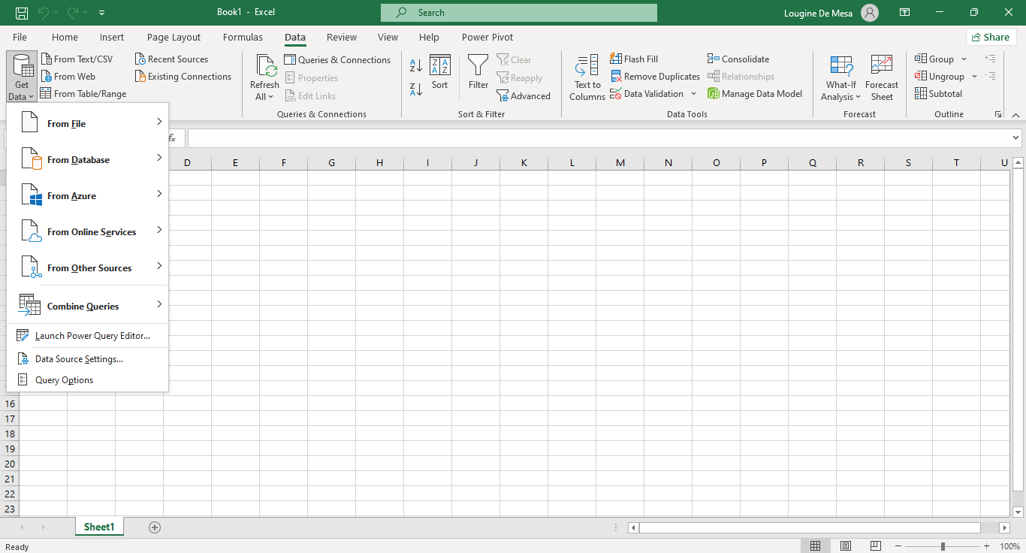
How to open Power Query Editor in Excel?
1
2
**navigate to the (1) Data tab on the ribbon and select (2) Get Data from the Get & Transform Data group. Then, choose (3) Launch Power Query Editor.
3

Slide 18
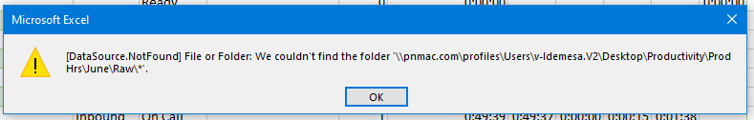
ERRORS and TROUBLESHOOTING
1. Data Source Not Found

Slide 19
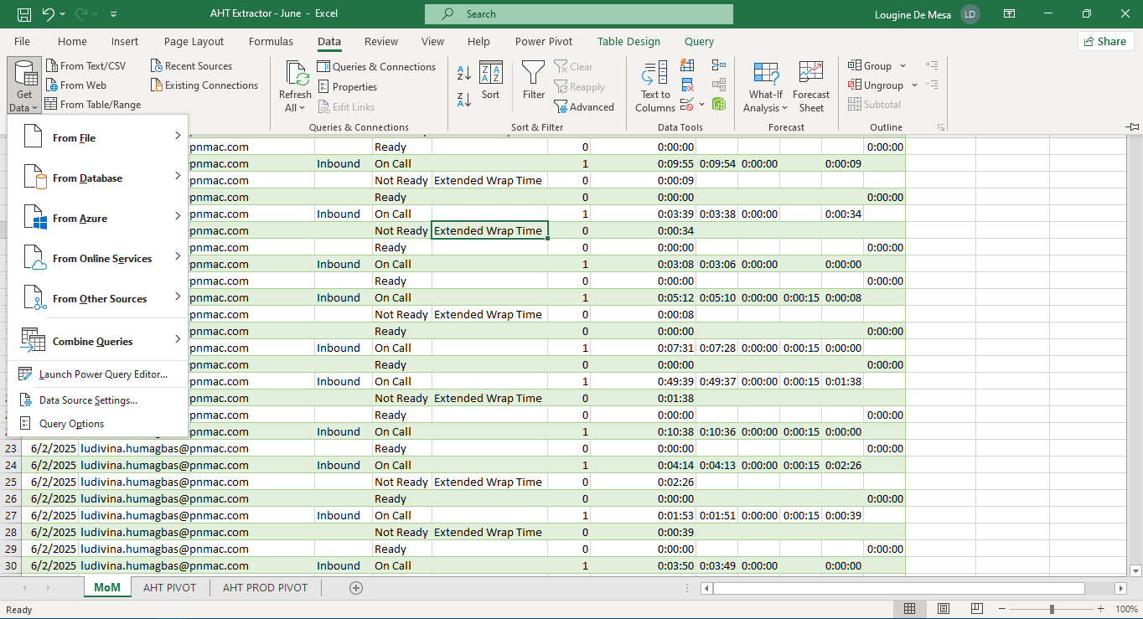
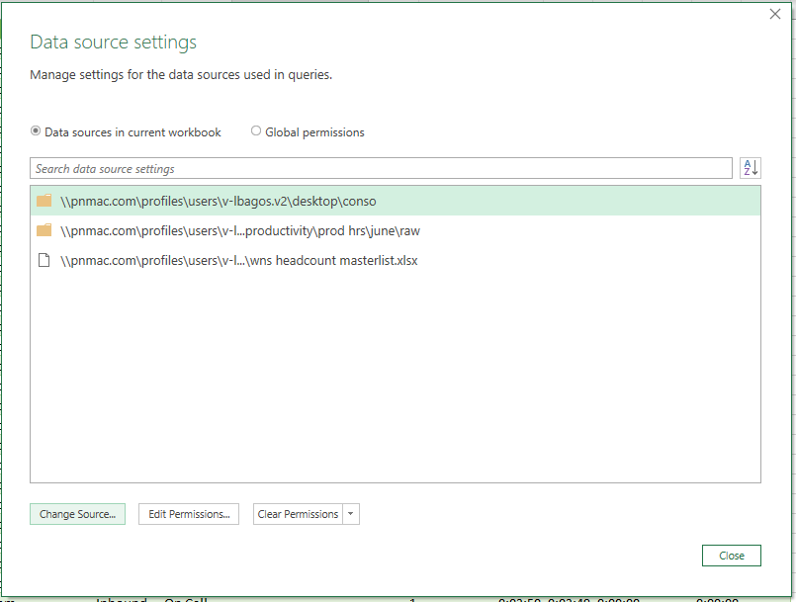
Data Source Not Found - Solution
Go to Data Tab
> Get Data
> Select Data Source Setting
Data Source Setting
> Select the Path you want to change
>Click the Change Source button

Slide 20
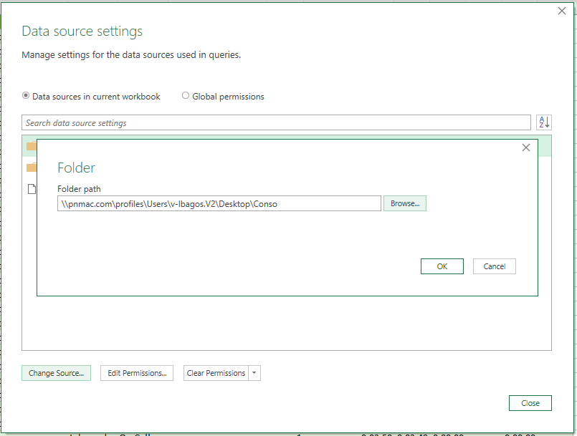
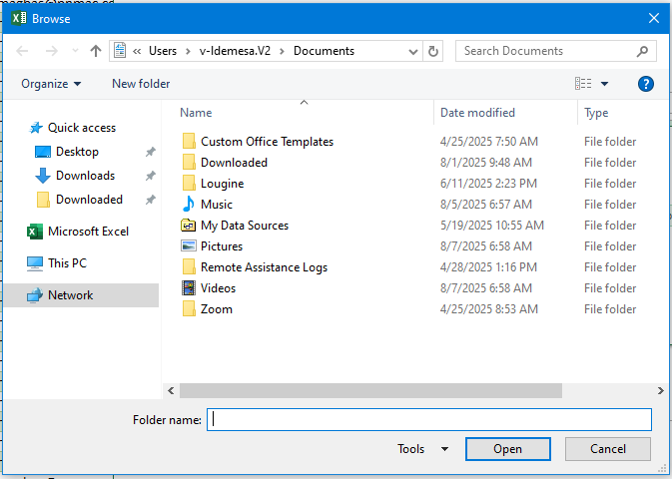
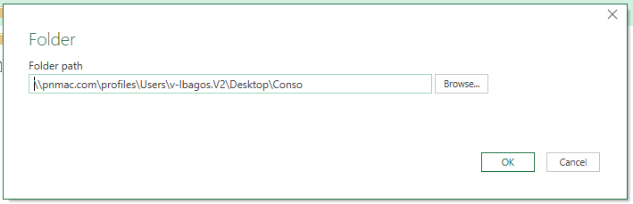
Click Browse then locate and select the file or folder of the new source Select OK then Close Finally Refresh

Slide 21
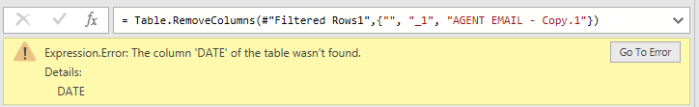
ERRORS and TROUBLESHOOTING
2. Column wasn’t Found

Slide 22
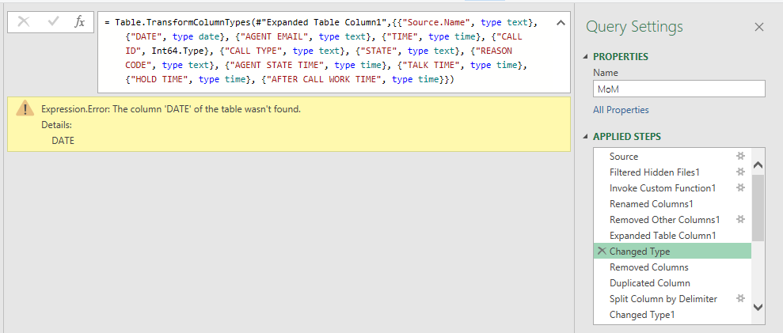
Two common reason for “Column wasn’t Found” Error
Column Name Changes in the Source
Column Removal from Source
Check the source and make sure you have the same header or column name on the Query. Open the Power Query Editor > On the Applied Steps, Check the line of steps where the error occur.
> On the formula bar, compare the header if what is written on the formula bar is the same in the data source.

Slide 23
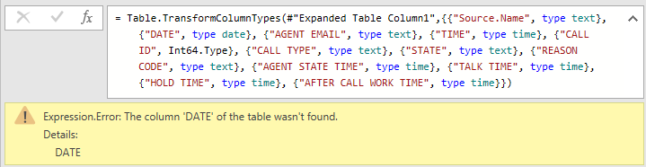

Column wasn’t Found - Sample
It shows here that the issue is on the Date column
Due to on the power query it is written as “DATE” and in the data source it is “date”.

Slide 24
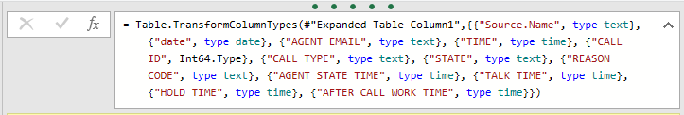

Column Name Changes in the Source - Solution You can edit the formula bar and replicate what is in the source or edit the header of the source.
Column Removal from Source – Solution You can add the missing column on the source file. If not needed you can remove the column on the formula bar of power query editor

Slide 25
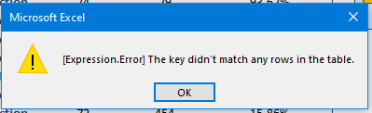
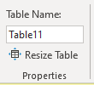
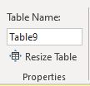
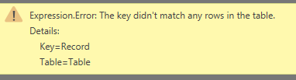
ERRORS and TROUBLESHOOTING
Error may occur if your data is in Table format. To fix it: >Go to your raw data and check the name of the table source. Rename the table on Table Design Ribbon, under Table Name
3. Didn’t match any rows in the table.
Inside Power query editor:

Slide 26
Demo / Q&A

Slide 27
Test your Knowledge
Create a sample of AHT report.
Use the provided Raw files and WNS Headcount Masterlist.
Use Power Query to get, combine, clean, and transform the data.
Create a pivot table showing the monthly view, per site, per cluster, and per tm.
Deadline is on “ “.

Slide 28
Thank you! Please like and follow for more.

